Slide 1

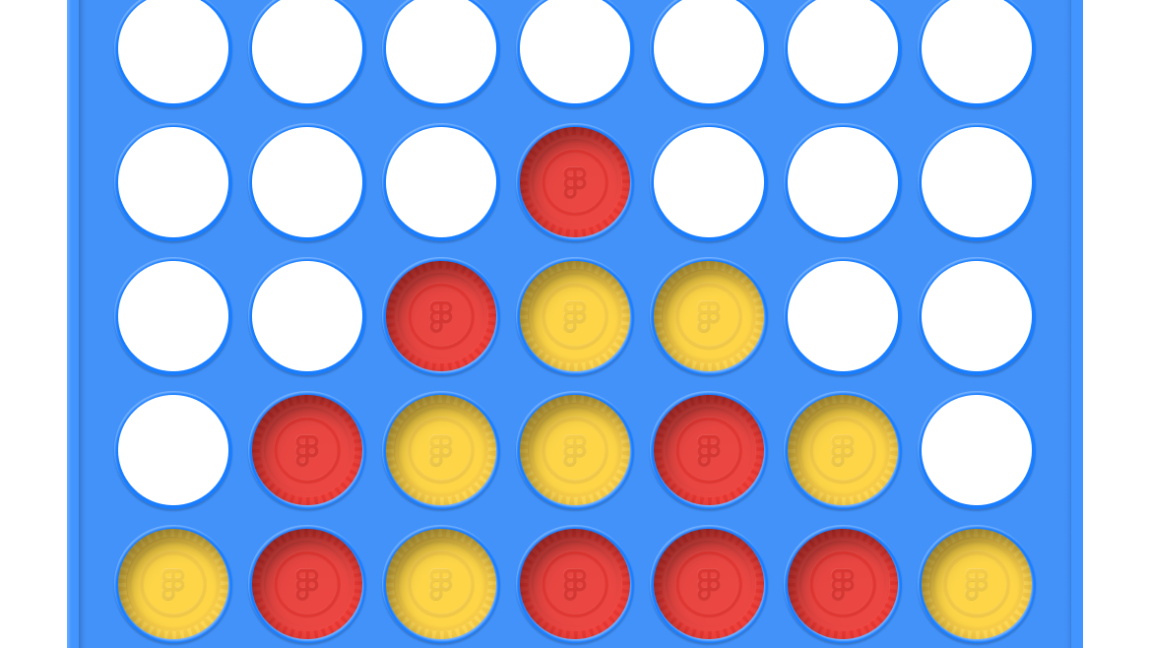
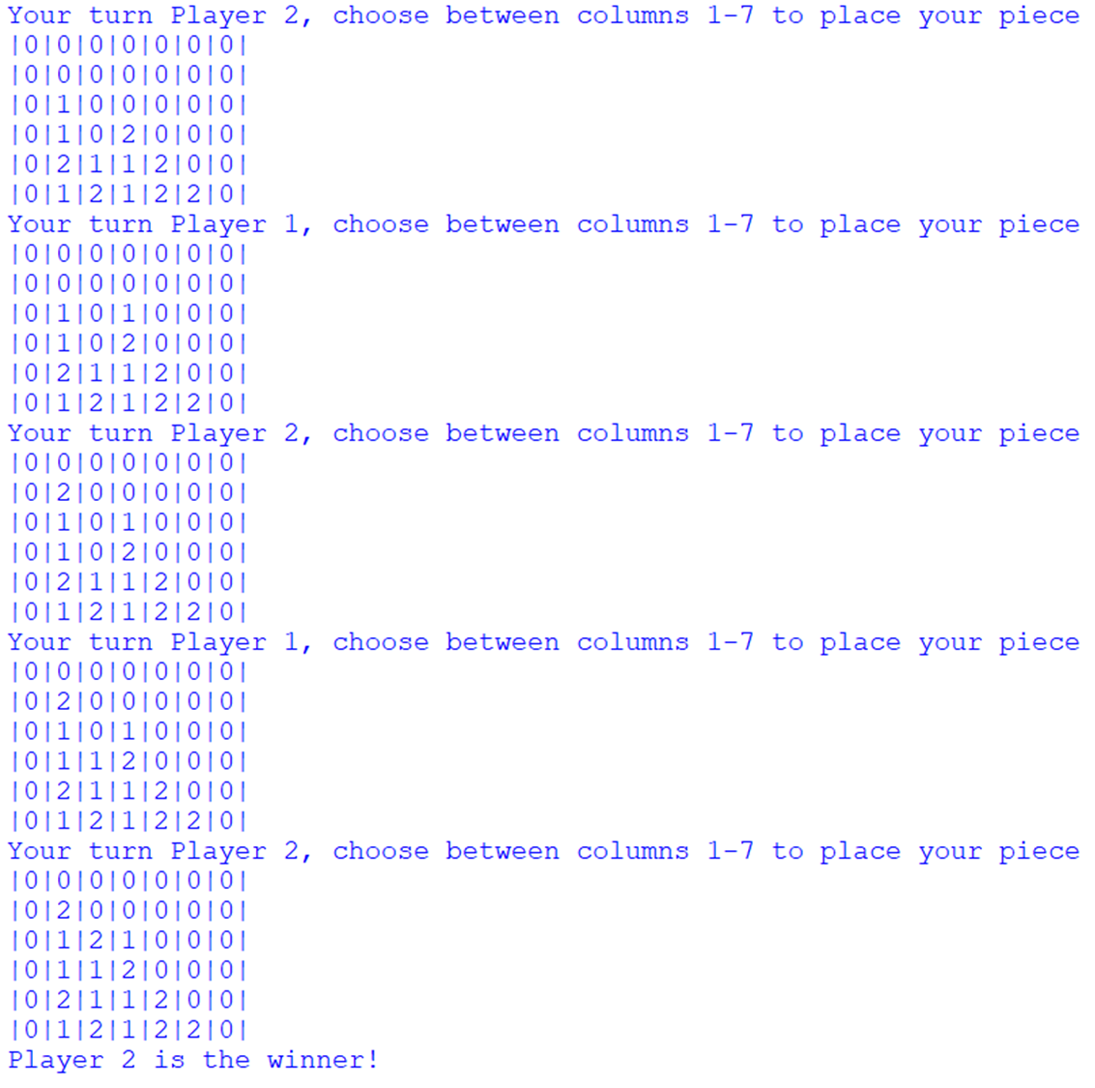
Connect-4 By Sage Smith
Connect-4 is a classic two player board game where both components compete for who can create a row of 4 first.
For my project, I created the game in Python where it is able to be played entirely within the terminal.
https://github.com/ksu-is/Connect4

